Slide 1

Raspberry pi Sensors
Lecturer: Reza Arjmandi
Summer 2016
Preface:
In this chapter, you will look at recipes for using sensors of various types that will allow the Raspberry Pi to measure temperature, light, and more.

Slide 2
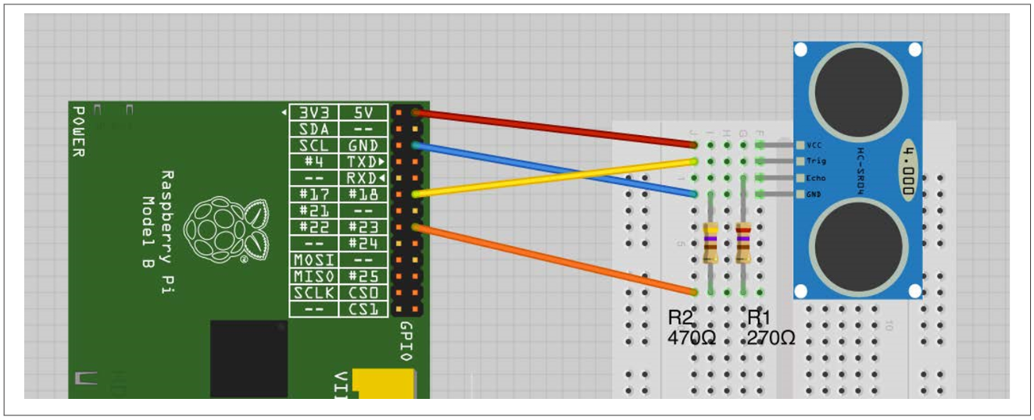
Measuring Distance
The resistors are necessary to reduce the echo output of the rangefinder from 5V to 3.3V

Slide 3
HCSR04 project
import RPi.GPIO as GPIO
import time
trigPin = 18
echoPin = 23
GPIO.setmode(GPIO.BCM)
GPIO.setup(trigPin, GPIO.OUT)
GPIO.setup(echoPin, GPIO.IN)
def SendTriggerPulse():
GPIO.output(trigPin, True)
time.sleep(0.0001)
GPIO.output(trigPin, False)
def WaitForEcho(value, timeout):
count = timeout
while GPIO.input(echoPin) != value and count > 0:
count = count - 1

Slide 4
HCSR04 project
def GetDistance():
SendTriggerPulse()
WaitForEcho(True, 100000)
start = time.time()
WaitForEcho(False, 100000)
finish = time.time()
pulseLen = finish - start
distCm = pulseLen / 0.000058
distInch = distCm / 2.5
return (distCm, distInch)
while True:
print("cm=%f\tinches=%f" % GetDistance())
time.sleep(1)

Slide 5
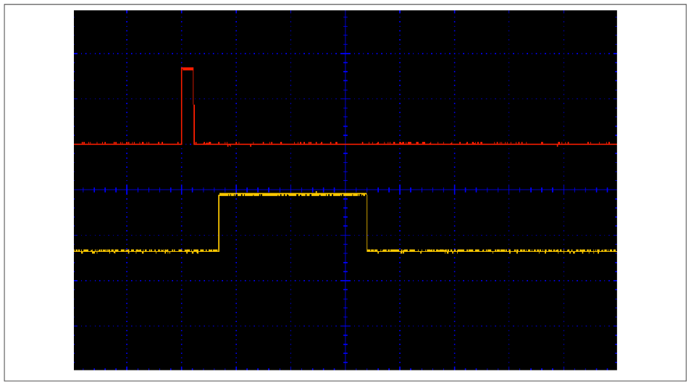
HCSR04 project
Following Figure shows an oscilloscope trace of the sensor in action. The top (red) trace is connected to trig and the bottom (yellow) trace is connected to echo. You can see that first the trig pin is taken high for a short pulse. There is then a short delay before the echo pin goes high. This then stays high for a period that is proportional to the distance from the sensor.

Slide 6
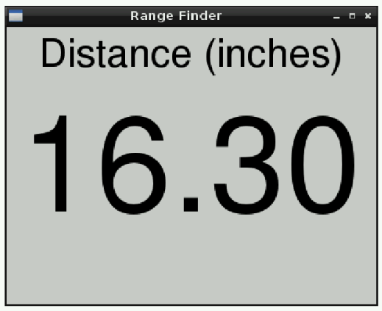
Displaying Sensor Values
Use the Tkinter library to open a window and write the reading on it as a label with a large font
This example uses data from the ultrasonic rangefinder of previous Recipe, complete that recipe first if you want to try out this example.

Slide 7
HCSR04_GUI project
class App:
def __init__(self, master):
self.master = master
frame = Frame(master)
frame.pack()
label = Label(frame, text='Distance (cm)', font=("Helvetica", 32))
label.grid(row=0)
self.readingLabel = Label(frame, text='00.00', font=("Helvetica", 110))
self.readingLabel.grid(row=1)
self.UpdateReading()
def UpdateReading(self):
cm, inch = GetDistance()
readingStr = "{:.2f}".format(cm)
self.readingLabel.configure(text=readingStr)
self.master.after(500, self.UpdateReading)
root = Tk()
root.wm_title('Range Finder')
app = App(root)
root.geometry("400x300+0+0")
root.mainloop()

Slide 8
Using a Keypad
Keypads are arranged in rows and columns, with a push switch on the intersection of each row or column. To find out which key is pressed, you first connect all the row and column connections to Raspberry Pi GPIO pins. So, for a 4 × 3 keypad, you will need four + three pins. By scanning each column in turn (setting it to output high) and reading the value of each of the row inputs, you can determine which (if any) key is pressed.
All the real action takes place in the get_key function. This enables each column in turn, by setting it to high. An inner loop then tests each of the rows in turn. If one of the rows is high, then the key name corresponding to that row and column is looked up in the keys array. If no keypress is detected, then the default value of key (0) is returned.

Slide 9
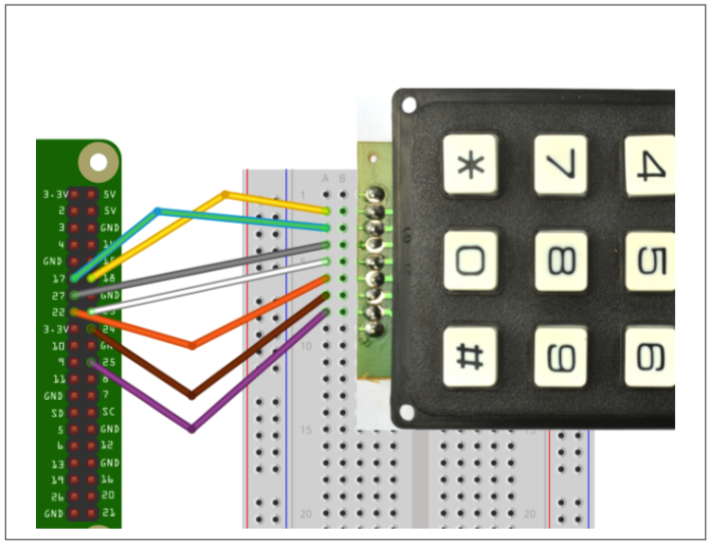
Keypad project

Slide 10
Keypad project
import RPi.GPIO as GPIO
import time
GPIO.setmode(GPIO.BCM)
rows = [17, 27, 22, 18]
cols = [23, 24, 25, 8]
keys = [
['1', '2', '3','F1'],
['4', '5', '6','F2'],
['7', '8', '9','F3'],
['Stop', '0', 'Start','Enter']]
for rowPin in rows:
GPIO.setup(rowPin, GPIO.IN, pull_up_down = GPIO.PUD_DOWN)
for colPin in cols:
GPIO.setup(colPin, GPIO.OUT)

Slide 11
Keypad project
def GetKey():
key = 0
for colNum, colPin in enumerate(cols):
GPIO.output(colPin, 1)
for rowNum, rowPin in enumerate(rows):
if GPIO.input(rowPin):
key = keys[rowNum][colNum]
GPIO.output(colPin, 0)
return key
while True:
key = GetKey()
if key :
print(key)
time.sleep(0.3)

Slide 12
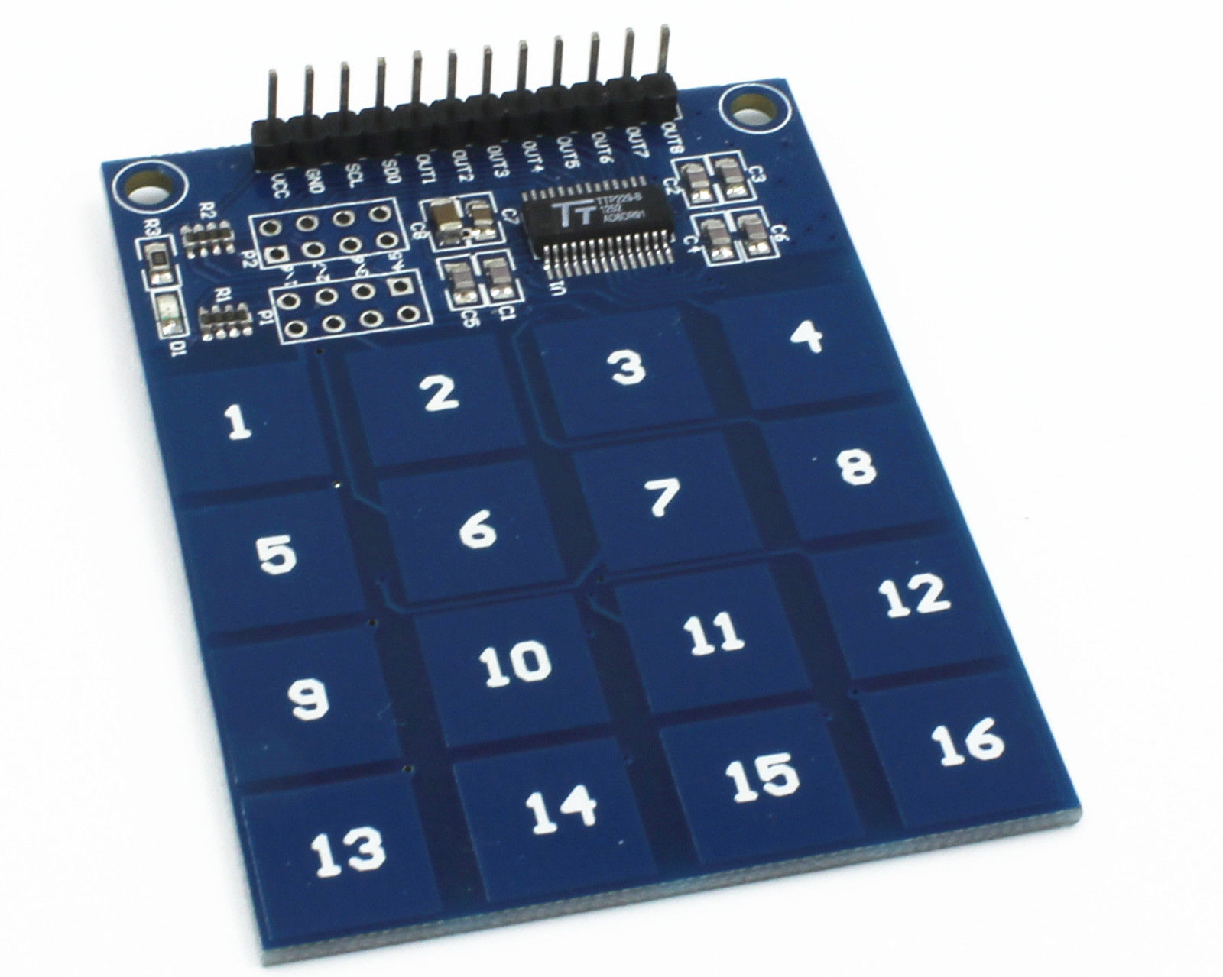
Using a Capacitive Touch Keypad

Slide 13
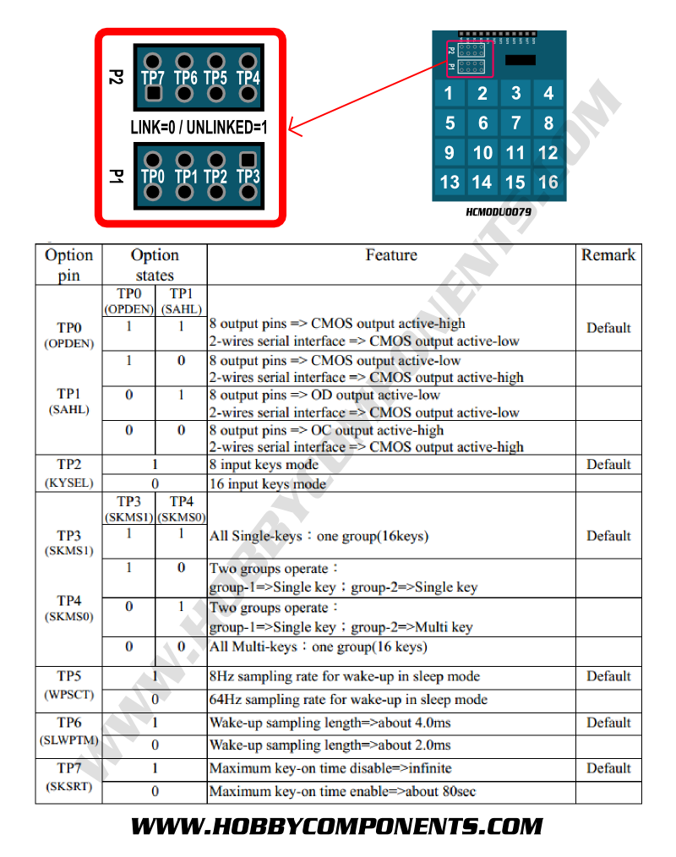
Touch_Keypad project

Slide 14
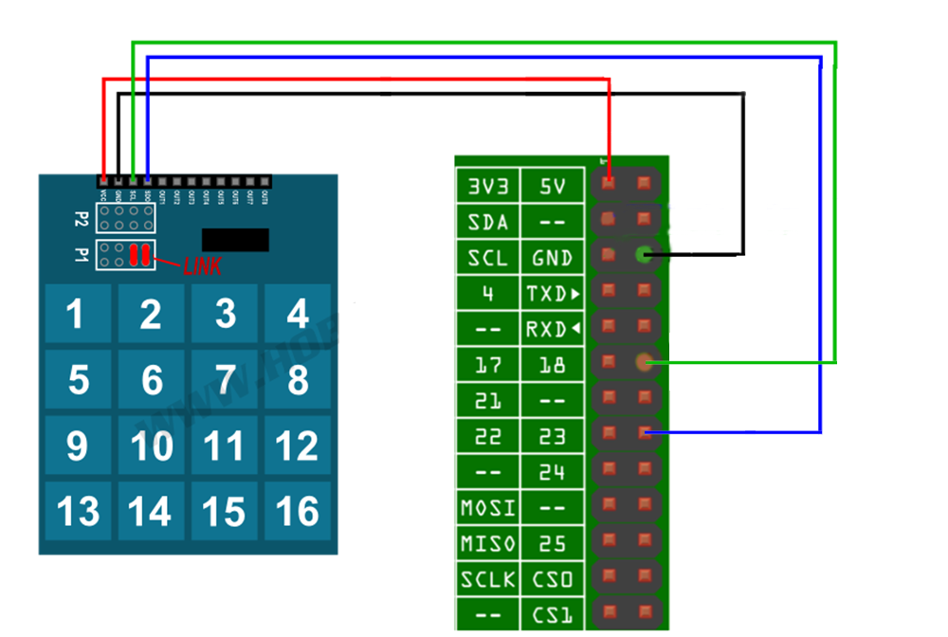
Touch_Keypad project

Slide 15
Touch_Keypad project
import RPi.GPIO as GPIO
import time
GPIO.setmode(GPIO.BCM)
GPIO.setup(18, GPIO.OUT)
GPIO.setup(23, GPIO.IN, pull_up_down = GPIO.PUD_UP)
def ReadKeyPad():
keyState = 0
for i in range(1, 17):
GPIO.output(18, 0)
if(GPIO.input(23) == 0):
keyState=i
GPIO.output(18, 1)
return keyState

Slide 16
Touch_Keypad project
lastKey = -1
while 1:
key = ReadKeyPad()
if(key != lastKey and key > 0):
print(key)
lastKey = key
time.sleep(0.1)

Slide 17
Using a Unipolar Stepper Motor
You want to drive a five-lead unipolar stepper motor using a Raspberry Pi.
Use a ULN2803 Darlington driver chip.
Stepper motors fit somewhere between DC motors and servo motors in the world of motor technologies. Like a regular DC motor, they can rotate continuously, but you can also very accurately position them by moving them a step at a time in either direction.
If you’re using Python 3, change the command raw_input to just input

Slide 18
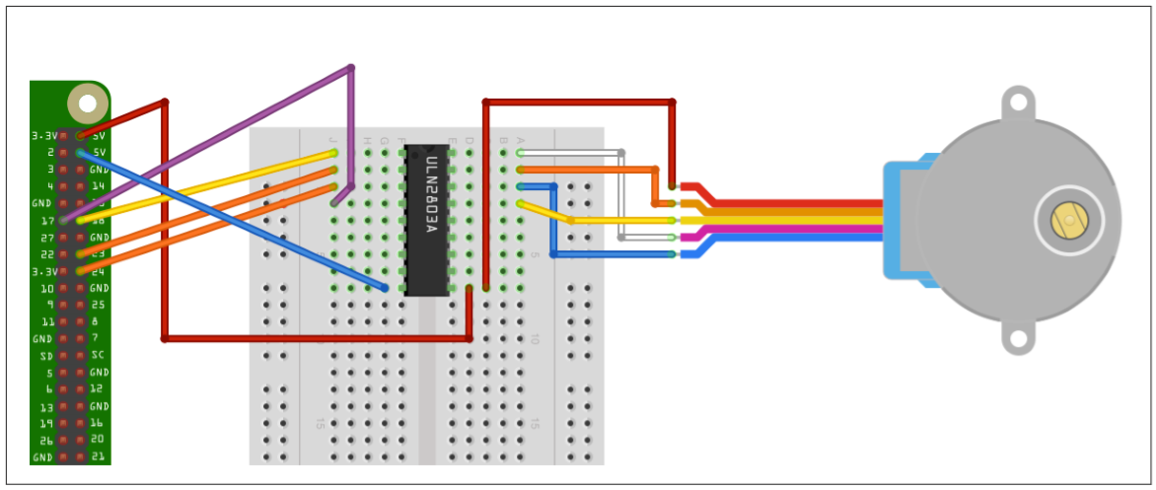
Stepper_Motor project

Slide 19
Stepper_Motor project
import RPi.GPIO as GPIO
import time
GPIO.setmode(GPIO.BCM)
coilA1Pin = 18
coilA2Pin = 23
coilB1Pin = 24
coilB2Pin = 17
GPIO.setup(coilA1Pin, GPIO.OUT)
GPIO.setup(coilA2Pin, GPIO.OUT)
GPIO.setup(coilB1Pin, GPIO.OUT)
GPIO.setup(coilB2Pin, GPIO.OUT)
forwardSeq = ['1010', '0110', '0101', '1001']
reverseSeq = list(forwardSeq) # to copy the list
reverseSeq.reverse()

Slide 20
Stepper_Motor project
def Forward(delay, steps):
for i in range(steps):
for step in forwardSeq:
SetStep(step)
time.sleep(delay)
def Backward(delay, steps):
for i in range(steps):
for step in reverseSeq:
SetStep(step)
time.sleep(delay)
def SetStep(step):
GPIO.output(coilA1Pin, step[0] == '1')
GPIO.output(coilA2Pin, step[1] == '1')
GPIO.output(coilB1Pin, step[2] == '1')
GPIO.output(coilB2Pin, step[3] == '1')

Slide 21
Stepper_Motor project
while True:
SetStep('0000')
delay = raw_input("Delay between steps (milliseconds)?")
steps = raw_input("How many steps forward? ")
Forward(int(delay) / 1000.0, int(steps))
SetStep('0000')
steps = raw_input("How many steps backwards? ")
Backward(int(delay) / 1000.0, int(steps))
When you run the program, you will be prompted for a delay between steps. This should be two or more. You will then be prompted for the number of steps in each direction

Slide 22
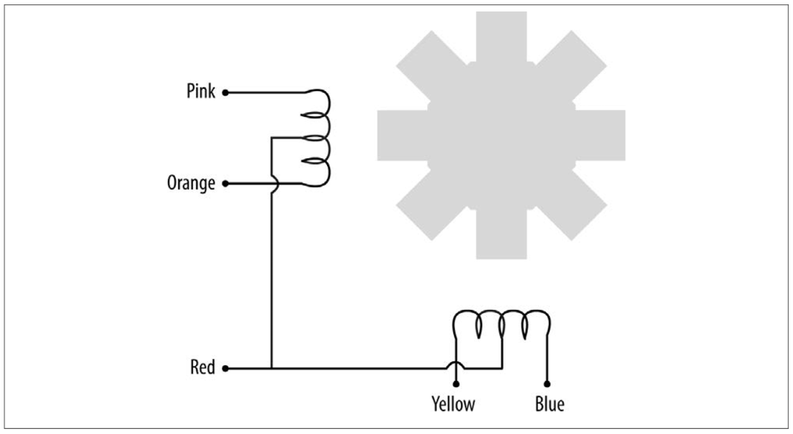
Stepper_Motor project
Stepper motors use a cogged rotor and electromagnets to nudge the wheel around a step at a time (following Figure). Note that the colors of the leads will vary.
Energizing the coils in a certain order drives the motor around. The number of steps that the stepper motor has in a 360-degree rotation is actually the number of teeth on the rotor.

Slide 23
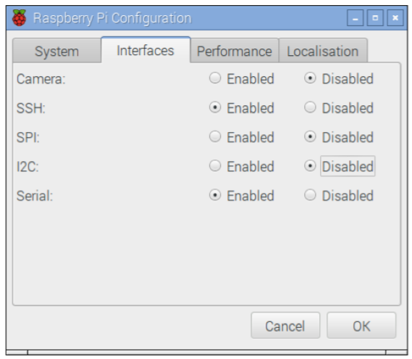
Setting Up I2C
For this recipe to work, you will also need to set up your Raspberry Pi for I2C, so follow recipe:
In the latest versions of Raspbian, enabling I2C is simply a matter of using the Raspberry Pi Configuration tool that you will find on the main menu under Preferences . Just check the box for I2C and click OK. You will be prompted to restart.

Slide 24
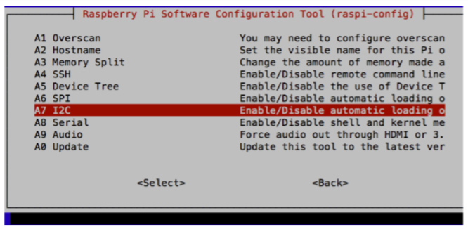
Setting Up I2C
On older versions of Raspbian, the raspi-config tool does the same job
$ sudo raspi-config
Then select Advanced from the menu and scroll down to I2C

Slide 25
Setting Up I2C
At this point, you will probably also want to install the Python I2C library by using the command:
$ sudo apt-get install python-smbus
You will then need to reboot the Raspberry Pi for the changes to take effect.

Slide 26
Using I2C Tools
You have an I2C device attached to your Raspberry Pi, and you want to check that it’s attached and find its I2C address.
From a Terminal window on your Pi, type the following commands to fetch and install the i2c-tools:
$ sudo apt-get install i2c-tools

Slide 27
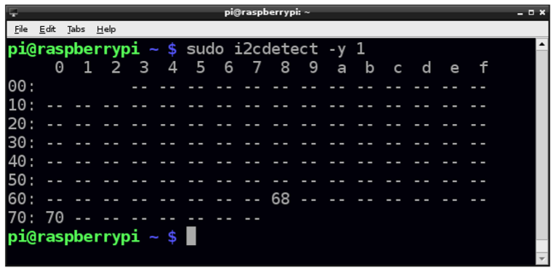
Using I2C Tools
Attach your I2C device to the Pi and run the command:
$ sudo i2cdetect -y 1
Note that if you are using a very old Raspberry Pi revision 1 board, you need to change 1 to 0 in the preceding line of code.
If I2C is available, you will see some output like that shown. This shows that two I2C addresses are in use—0x68 and 0x70.

Slide 28
Using an OLED Graphical Display
Some of these displays have just four pins, whereas others have eight pins. The 8-pin varieties (including Adafruit’s displays) have more pins because they have both an I2C and SPI interfaces. The 4-pin displays just have an I2C.
The I2C interface is better suited for use with the Raspberry Pi because the display operates at 5V, and both interface pins for I2C (SDA and SCL) are 3.3V outputs from the Raspberry Pi, whereas the SPI interface’s MISO pin is a 3.3V input that requires level conversion before connecting to the Raspberry Pi.
The connections between the Raspberry Pi and the module are as follows:
• VCC on the display to 5V on the Raspberry Pi GPIO connector
• GND on the display to GND on the Raspberry Pi GPIO connector
• SDA on the display to GPIO 2 (SDA) on the Raspberry Pi GPIO connector
• SCL on the display to GPIO 3 (SCL) on the Raspberry Pi GPIO connector s

Slide 29
Using an OLED Graphical Display
Adafruit has a library for these displays. Install it by using these commands:
$ git clone https://github.com/adafruit/Adafruit_Python_SSD1306.git
$ cd Adafruit_Python_SSD1306
$ sudo python setup.py install
This library uses the Python Image Library (PIL), which can be installed by using the command:
$ sudo pip install pillow

Slide 30
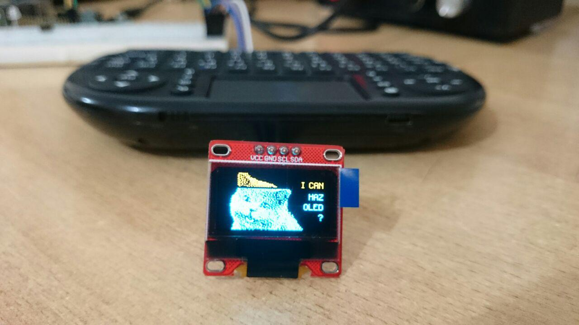
OLED_Image project

Slide 31
OLED_Image project
import time
import Adafruit_GPIO.SPI as SPI
import Adafruit_SSD1306
from PIL import Image
# Raspberry Pi pin configuration:
RST = 24
# 128x64 display with hardware I2C:
disp = Adafruit_SSD1306.SSD1306_128_64(rst=RST)
# Initialize library.
disp.begin()
# Clear display.
disp.clear()
disp.display()

Slide 32
OLED_Image project
image = Image.open('happycat_oled_64.ppm').convert('1')
# Display image.
disp.image(image)
disp.display()

Slide 33
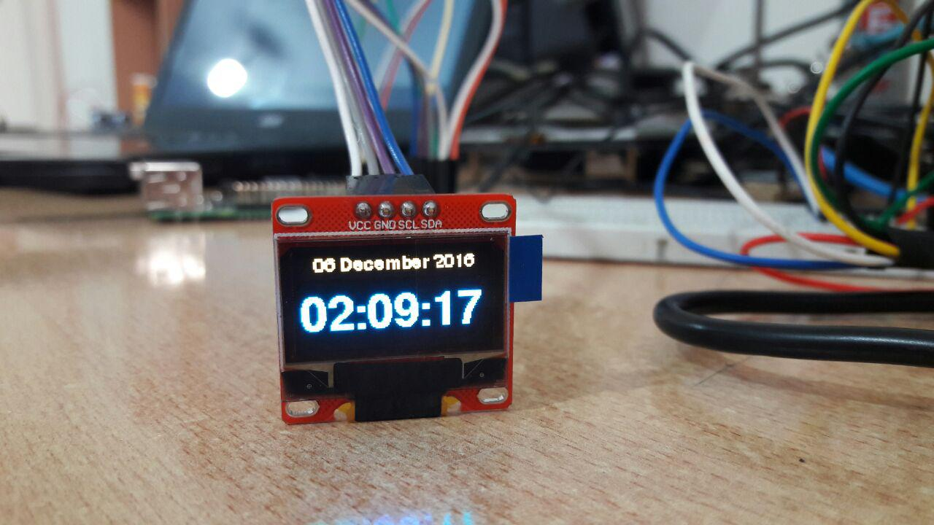
OLED_Clock project

Slide 34
OLED_Clock project
import Adafruit_SSD1306
from datetime import datetime
import time
from PIL import Image
from PIL import ImageDraw
from PIL import ImageFont
# Setup Display
RST=24
device = Adafruit_SSD1306.SSD1306_128_64(rst=RST)
device.begin()
device.clear()
device.display()
width = device.width
height = device.height
fontFile = '/usr/share/fonts/truetype/freefont/FreeSansBold.ttf'
smallFont = ImageFont.truetype(fontFile, 12)
largeFont = ImageFont.truetype(fontFile, 33)

Slide 35
OLED_Clock project
# Display a message on 3 lines, first line big font
def DisplayMessage(line1, line2):
global device
image = Image.new('1', (width, height))
draw = ImageDraw.Draw(image)
maxWidth, unused = draw.textsize(line1, font=largeFont)
#with canvas(deviccd e) as draw:
draw.text((10, 0), line1, font=smallFont, fill=255)
draw.text((0, 20), line2, font=largeFont, fill=255)
device.image(image)
device.display()
while True:
now = datetime.now()
dateMessage = '{:%d %B %Y}'.format(now)
timeMessage = '{:%H:%M:%S}'.format(now)
DisplayMessage(dateMessage,timeMessage)
time.sleep(0.1)

Slide 36
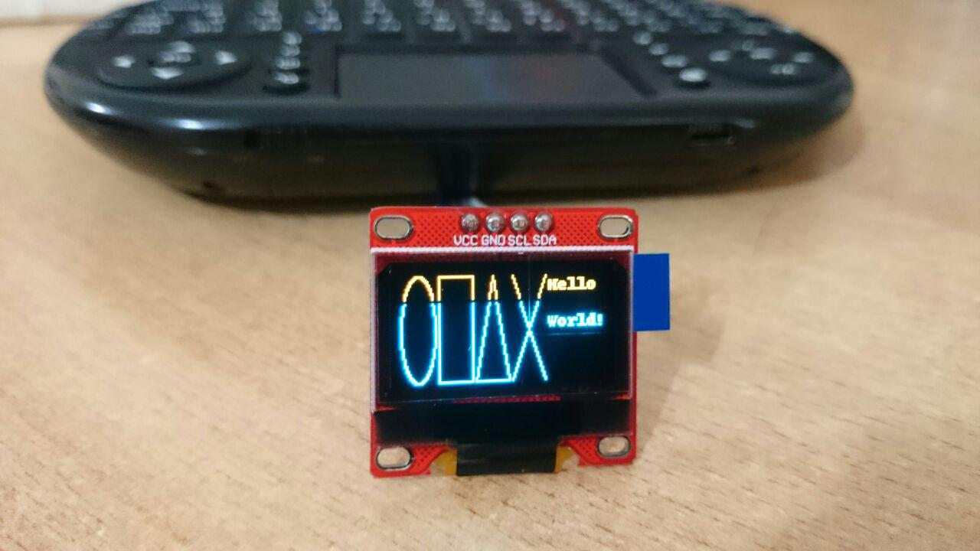
OLED_Shapes project

Slide 37
OLED_Shapes project
import time
import Adafruit_GPIO.SPI as SPI
import Adafruit_SSD1306
from PIL import Image
from PIL import ImageDraw
from PIL import ImageFont
# Raspberry Pi pin configuration:
RST = 24
# 128x32 display with hardware I2C:
disp = Adafruit_SSD1306.SSD1306_128_64(rst=RST)
# Initialize library.
disp.begin()
# Clear display.
disp.clear()
disp.display()

Slide 38
OLED_Shapes project
# Create blank image for drawing.
# Make sure to create image with mode '1' for 1-bit color.
width = disp.width
height = disp.height
image = Image.new('1', (width, height))
# Get drawing object to draw on image.
draw = ImageDraw.Draw(image)
# Draw a black filled box to clear the image.
draw.rectangle((0, 0, width, height), outline = 0, fill = 0)
# Draw some shapes.
# First define some constants to allow easy resizing of shapes.
padding = 2
shapeWidth = 20
top = padding
bottom = height - padding

Slide 39
OLED_Shapes project
# Move left to right keeping track of the current x position for drawing shapes.
x = padding
# Draw an ellipse.
draw.ellipse((x, top , x + shapeWidth, bottom), outline = 255, fill = 0)
x += shapeWidth + padding
# Draw a rectangle.
draw.rectangle((x, top, x+shapeWidth, bottom), outline = 255, fill = 0)
x += shapeWidth + padding
# Draw a triangle.
draw.polygon([(x, bottom), (x + shapeWidth / 2, top), (x + shapeWidth, bottom)], outline = 255, fill = 0)
x += shapeWidth + padding
# Draw an X.
draw.line((x, bottom, x + shapeWidth, top), fill = 255)
draw.line((x, top, x + shapeWidth, bottom), fill = 255)
x += shapeWidth + padding

Slide 40
OLED_Shapes project
# Load default font.
font = ImageFont.load_default()
# Write two lines of text.
draw.text((x, top), 'Hello', font = font, fill = 255)
draw.text((x, top+20), 'World!', font = font, fill = 255)
# Display image.
disp.image(image)
disp.display()

Slide 41
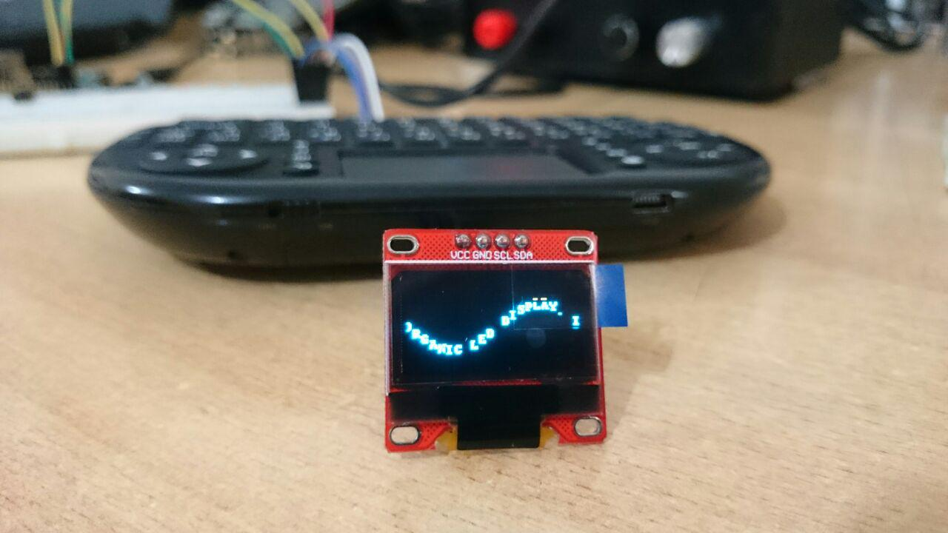
OLED_Animate project

Slide 42
OLED_Animate project
import math
import time
import Adafruit_GPIO.SPI as SPI
import Adafruit_SSD1306
from PIL import Image
from PIL import ImageFont
from PIL import ImageDraw
# Raspberry Pi pin configuration:
RST = 24
# 128x32 display with hardware I2C:
disp = Adafruit_SSD1306.SSD1306_128_64(rst=RST)
# Initialize library.
disp.begin()

Slide 43
OLED_Animate project
# Get display width and height.
width = disp.width
height = disp.height
# Clear display.
disp.clear()
disp.display()
# Create image buffer.
# Make sure to create image with mode '1' for 1-bit color.
image = Image.new('1', (width, height))
# Load default font.
font = ImageFont.load_default()
draw = ImageDraw.Draw(image)

Slide 44
OLED_Animate project
text = "9th Raspberry Pi Course ********** Shahed University"
maxWidth, unused = draw.textsize(text, font=font)
# Set animation and sine wave parameters.
amplitude = height / 4
offset = height / 2 - 4
velocity = -2
startPos = width
print('Press Ctrl-C to quit.')
pos = startPos

Slide 45
OLED_Animate project
while True:
# Clear image buffer by drawing a black filled box. draw.rectangle((0,0,width,height), outline=0, fill=0)
# Enumerate characters and draw them offset vertically based on a sine wave.
x = pos
for i, c in enumerate(text):
# Stop drawing if off the right side of screen.
if x > width:
break
# Calculate width but skip drawing if off the left side of screen.
if x < -10:
charWidth, charHeight = draw.textsize(c, font=font)
x += charWidth
continue
# Calculate offset from sine wave.
y = offset+math.floor(amplitude*math.sin(x/float(width)*2.0*math.pi))

Slide 46
OLED_Animate project
# Draw text.
draw.text((x, y), c, font=font, fill=255)
# Increment x position based on chacacter width.
charWidth, charHeight = draw.textsize(c, font=font)
x += charWidth
# Draw the image buffer.
disp.image(image)
disp.display()
# Move position for next frame.
pos += velocity
# Start over if text has scrolled completely off left side of screen.
if pos < -maxwidth:
pos = startpos
# Pause briefly before drawing next frame.
time.sleep(0.1)

Slide 47


Contact us
www.e-system.ir
Info@e-system.ir

